Slide 1
A new rhythm, a jazzy rhythm!

Slide 2
As a school with a full-day schedule, we want to give new rhythms to the school day in order to facilitate holistic learning.
Learning through participation: Increased responsibility for oneself, the class, the school and also beyond.
IMPROVED CONDITIONS
FOR OUTSTANDING PERFORMANCE
AND COMPENSATION FOR EDUCATIONAL DISADVANTAGES
"Agile working" within the teaching staff and in the classroom
Sustainable learning through enhanced self-determination
Meaningful digitalisation
Interlocking learning and relaxation phases
Facilitate mixed-age learning, promote project work
New rhythm &
homework becomes schoolwork

Slide 4
As a school with a full-day schedule, we want to give new rhythms to the school day in order to facilitate holistic learning.
The new school rhythm
takes into account the biorhythms of young people and balances learning and relaxation phases.
supports planned and continuous promotion of individual learning. By creating better conditions for special achievements and compensating for disadvantages, enabling mixed-age learning and encouraging project work, it ensures a variously stimulating school day.
offers more opportunities for co-creation. Greater self-determination makes learning more sustainable. Our students take greater responsibility for themselves, their class or school community, and beyond the school. By (having to) link personal initiative and public spirit, participation and social engagement are strengthened.

Slide 5
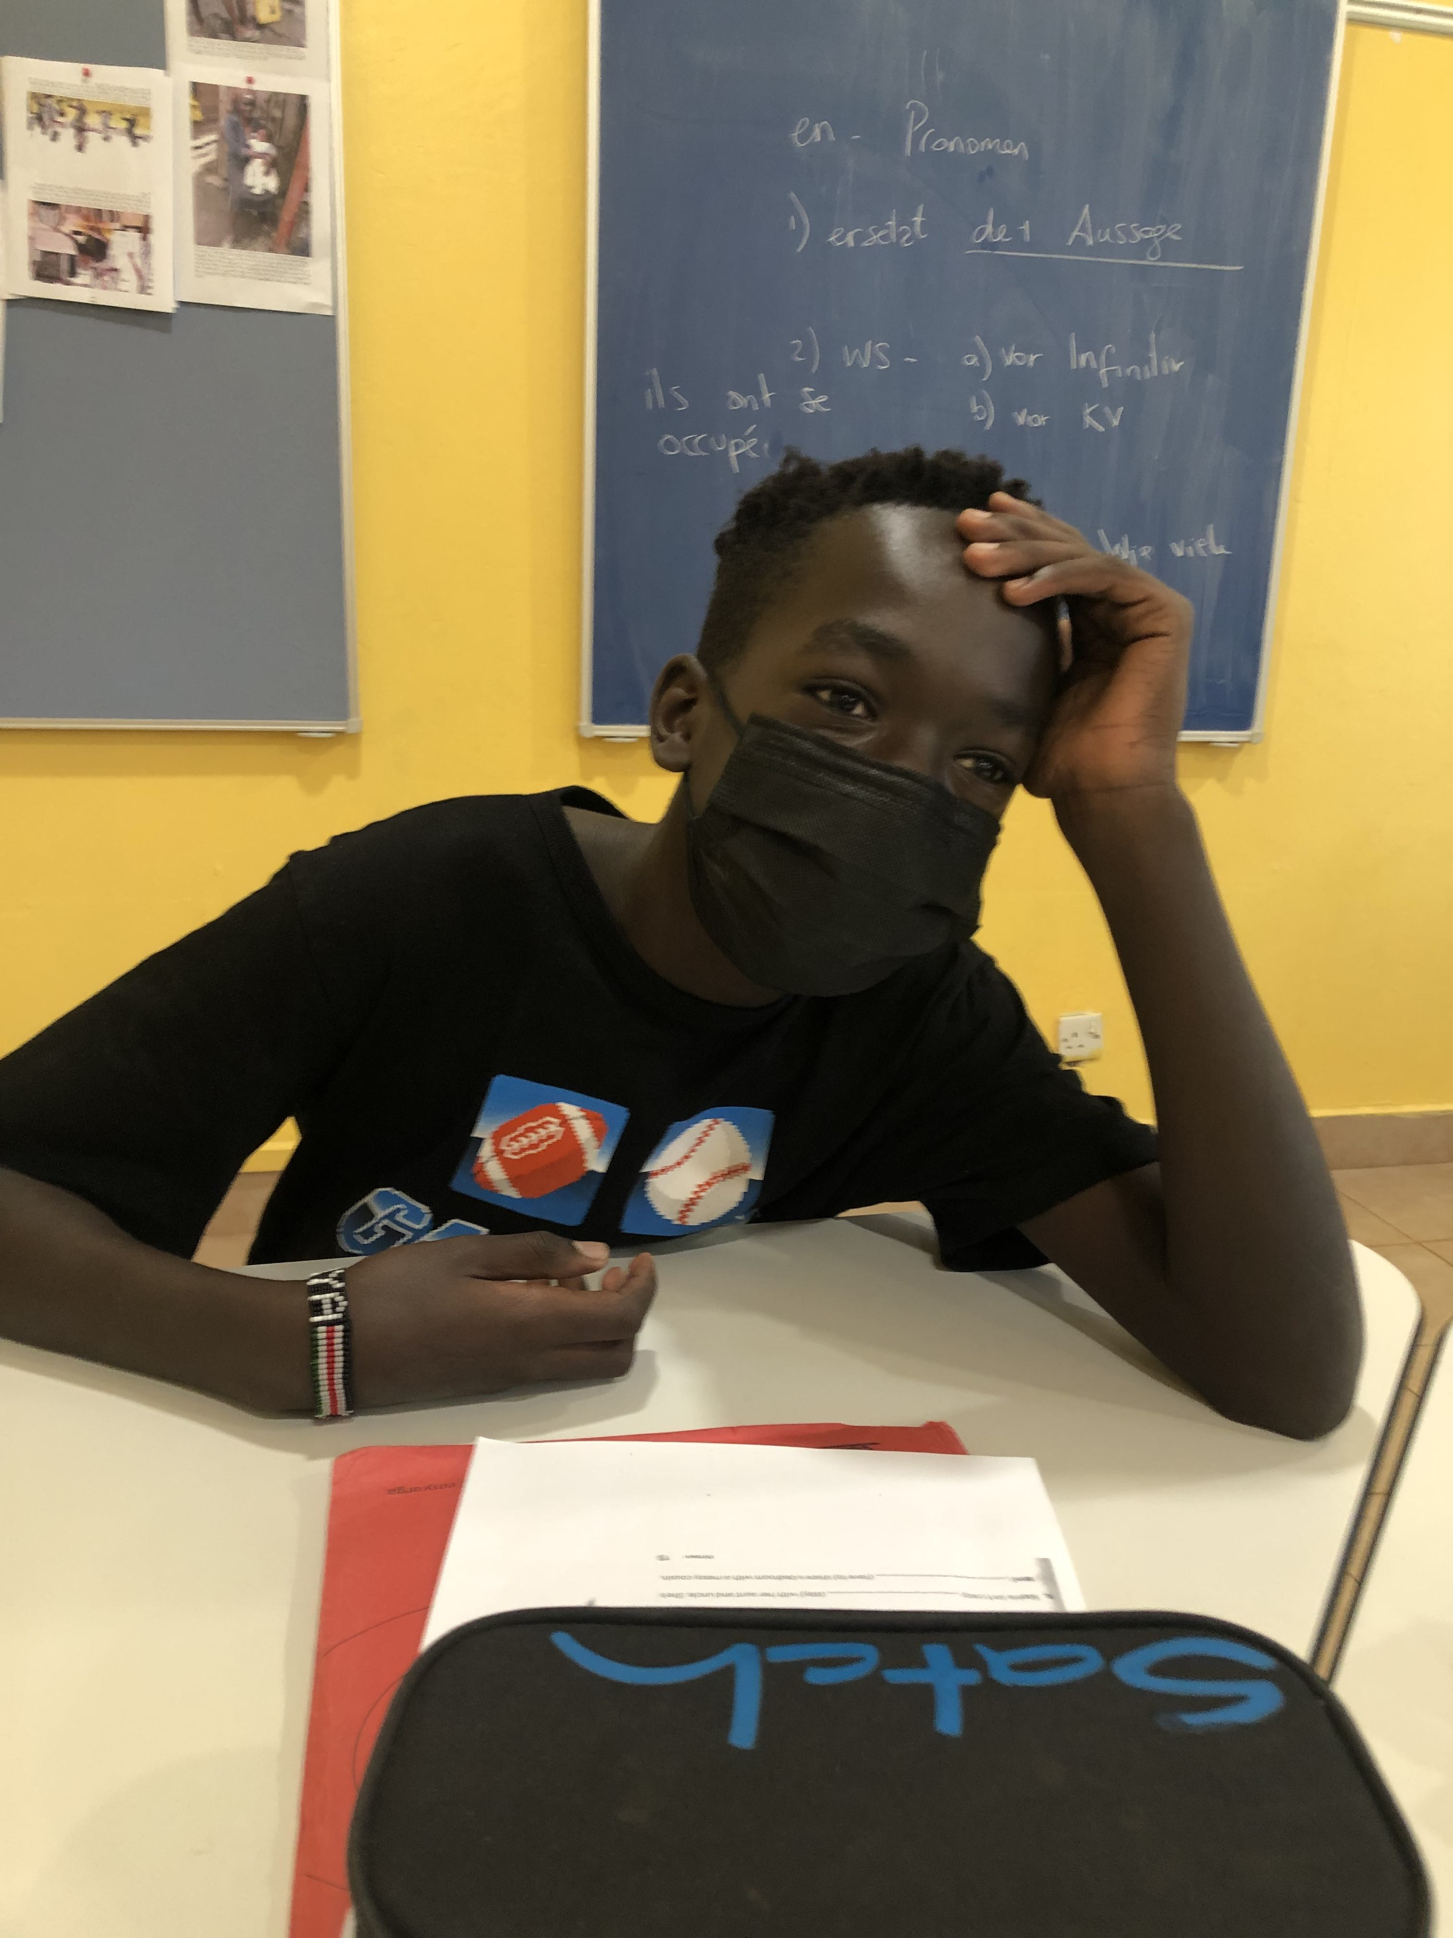
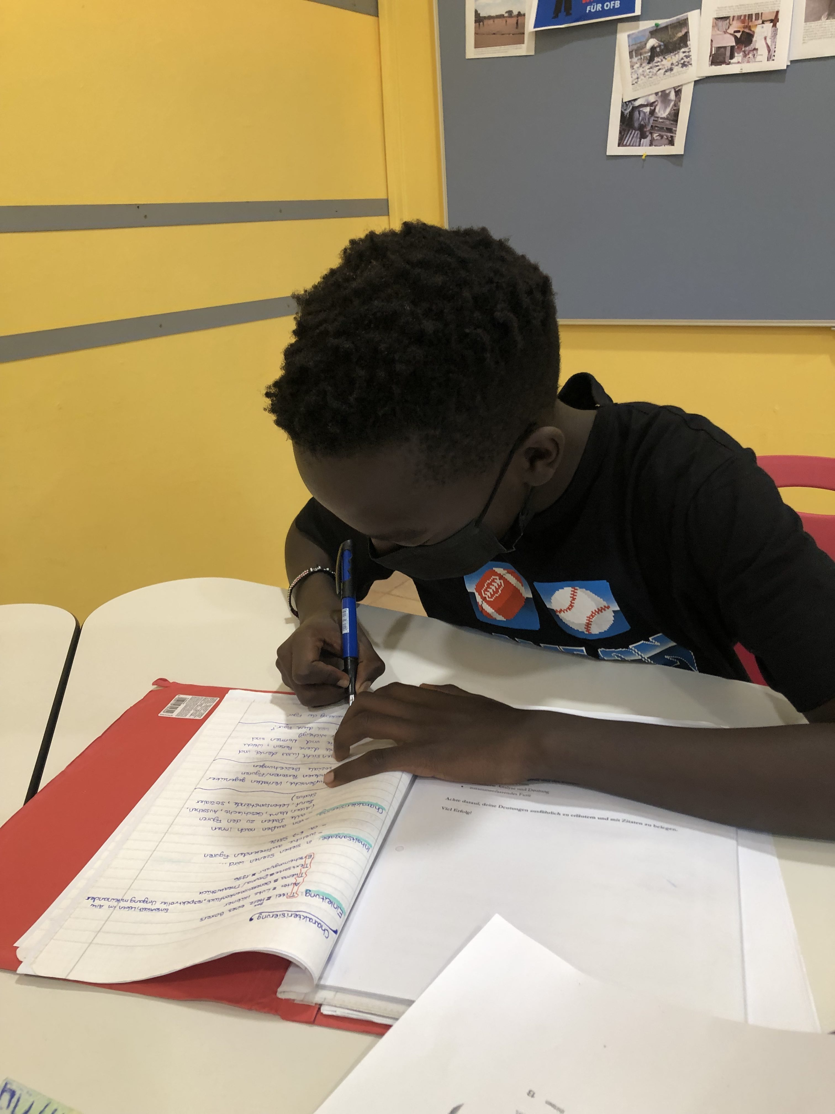
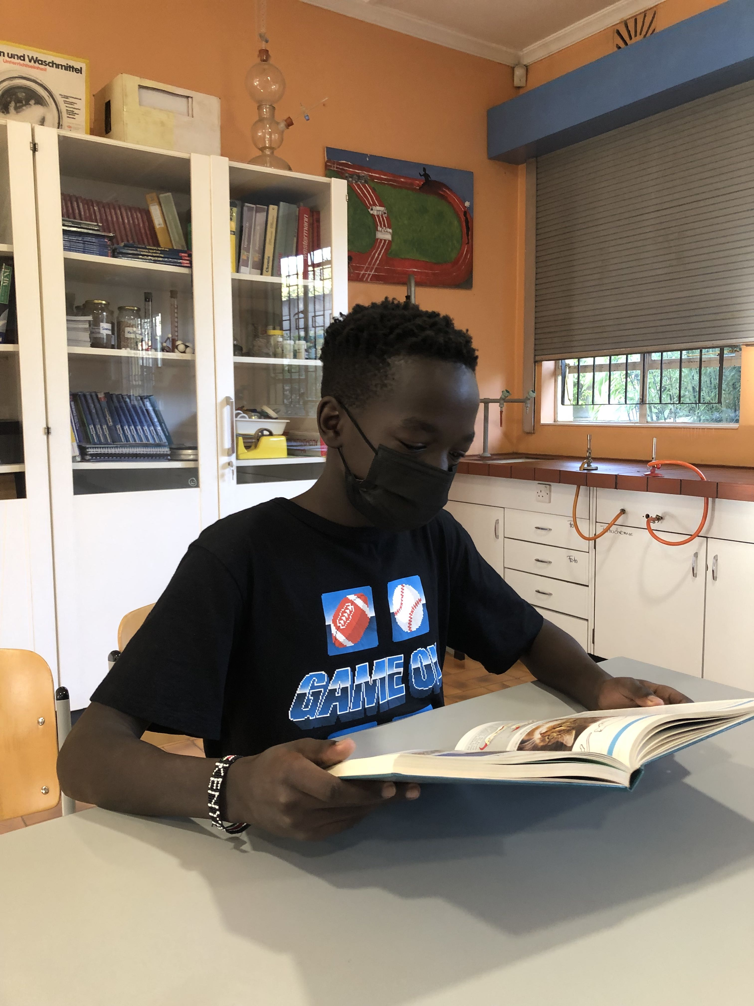
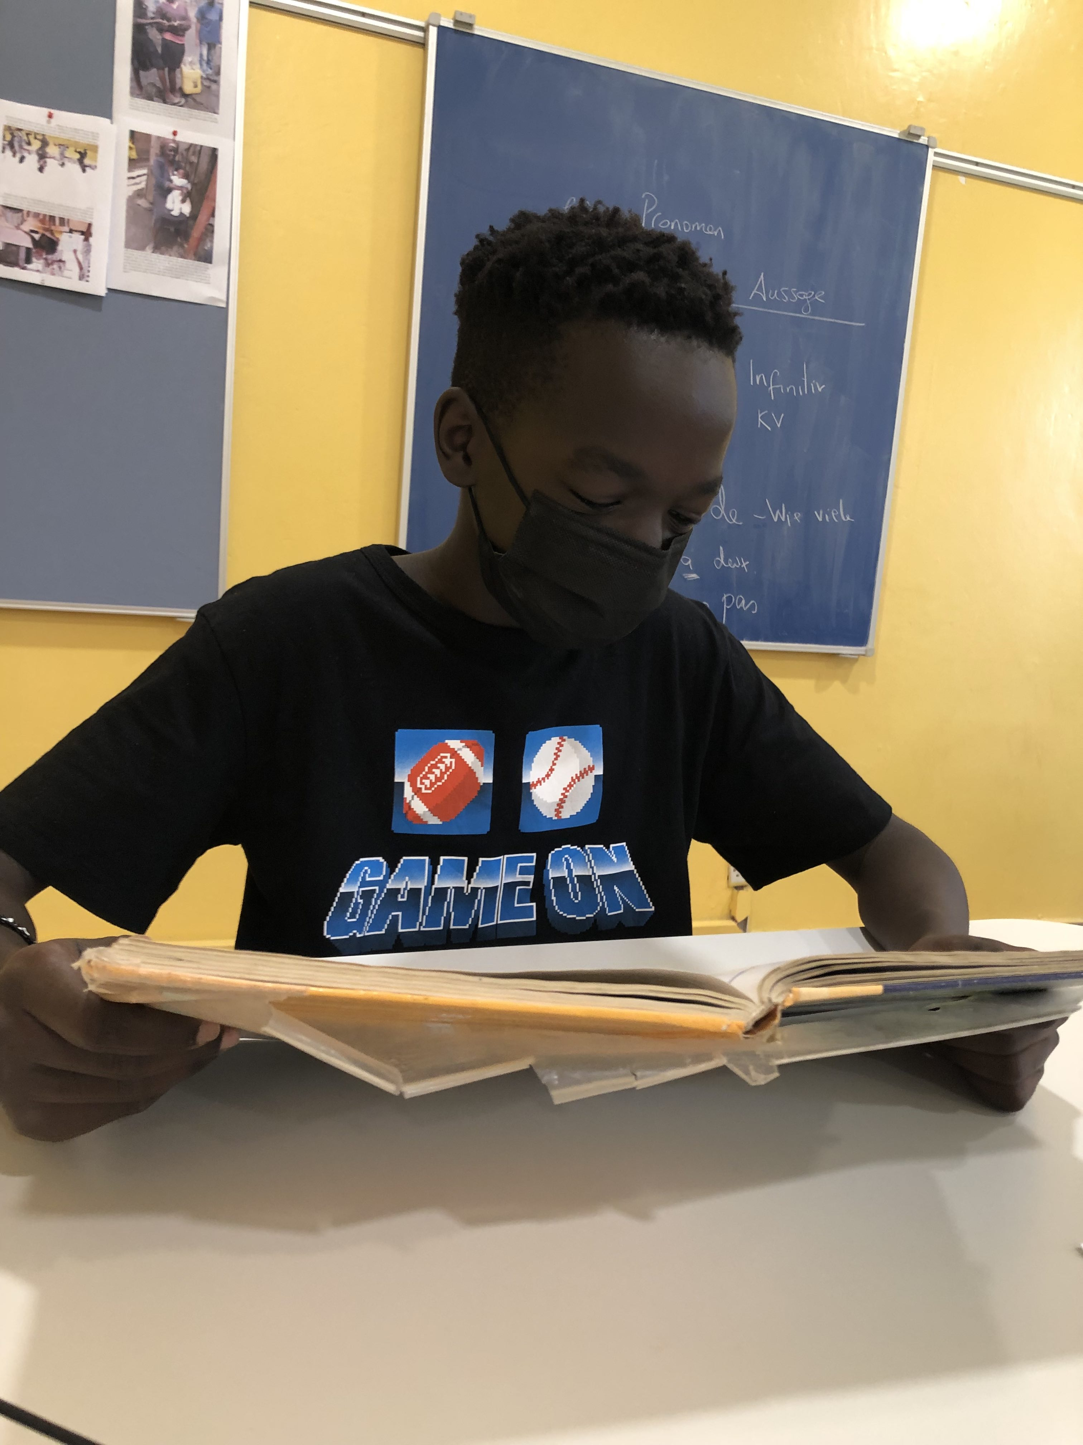
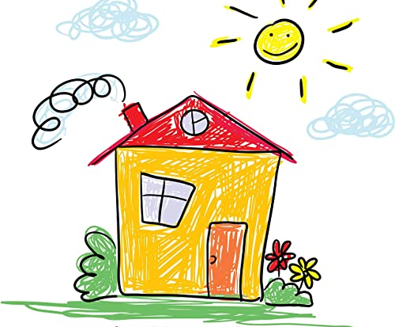
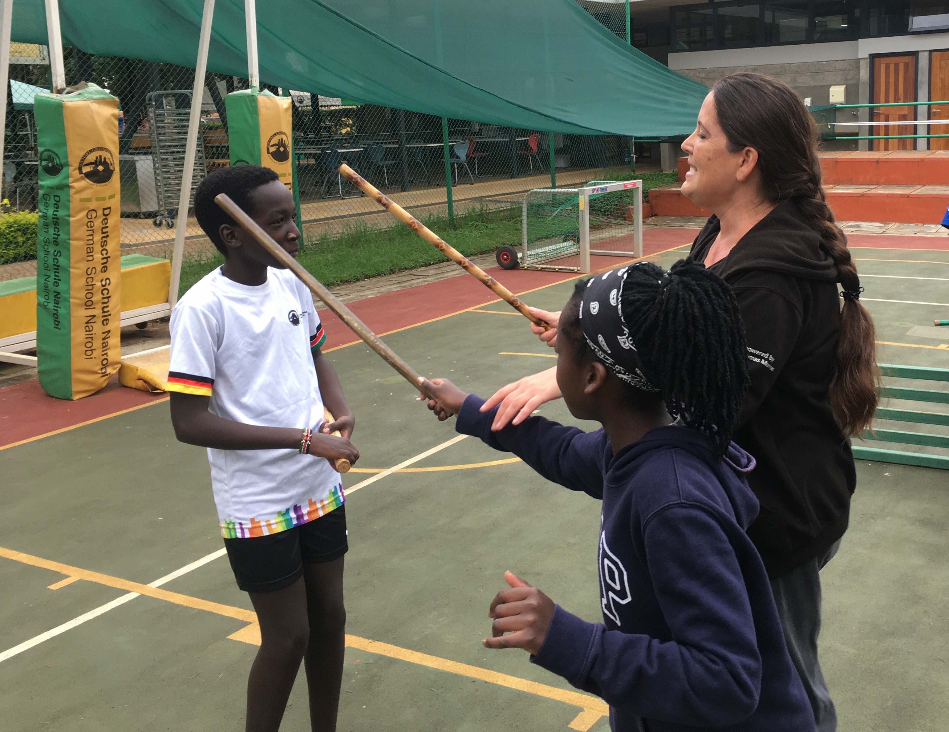
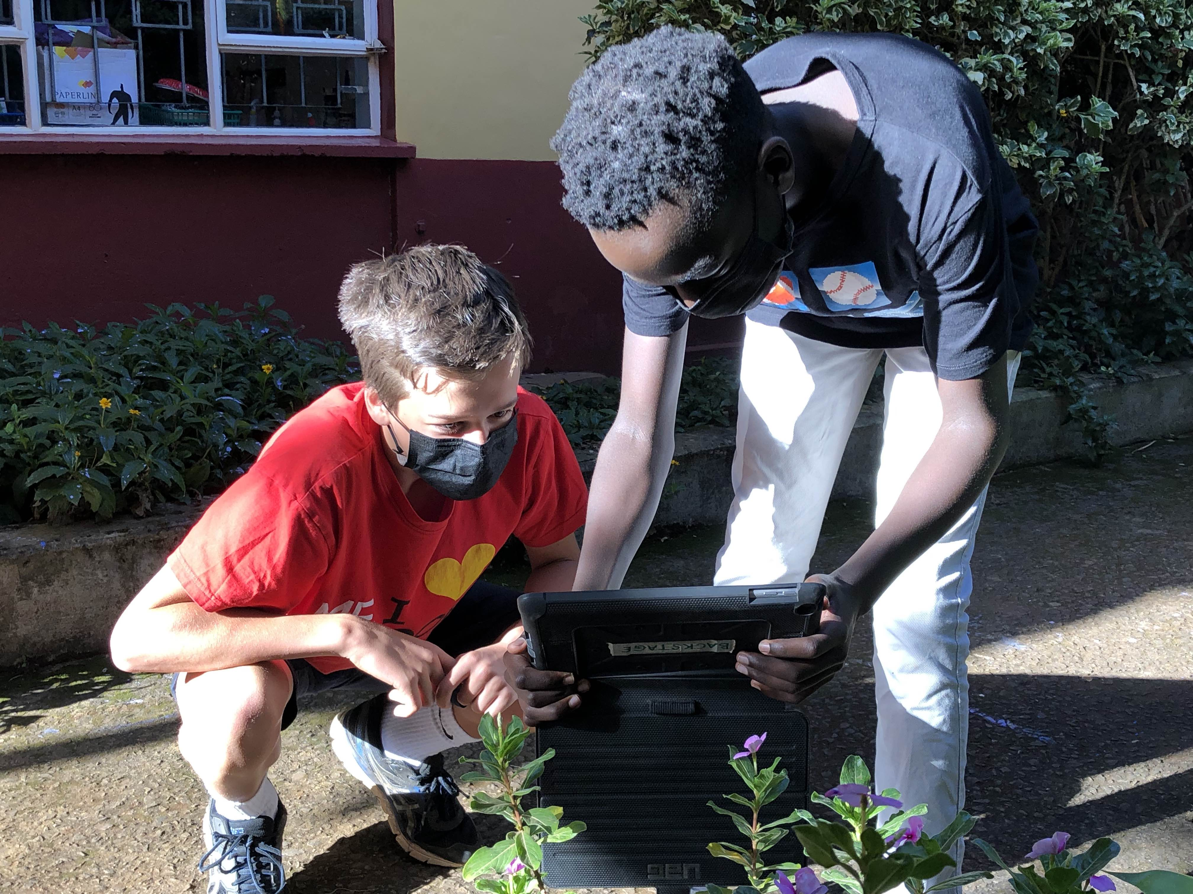
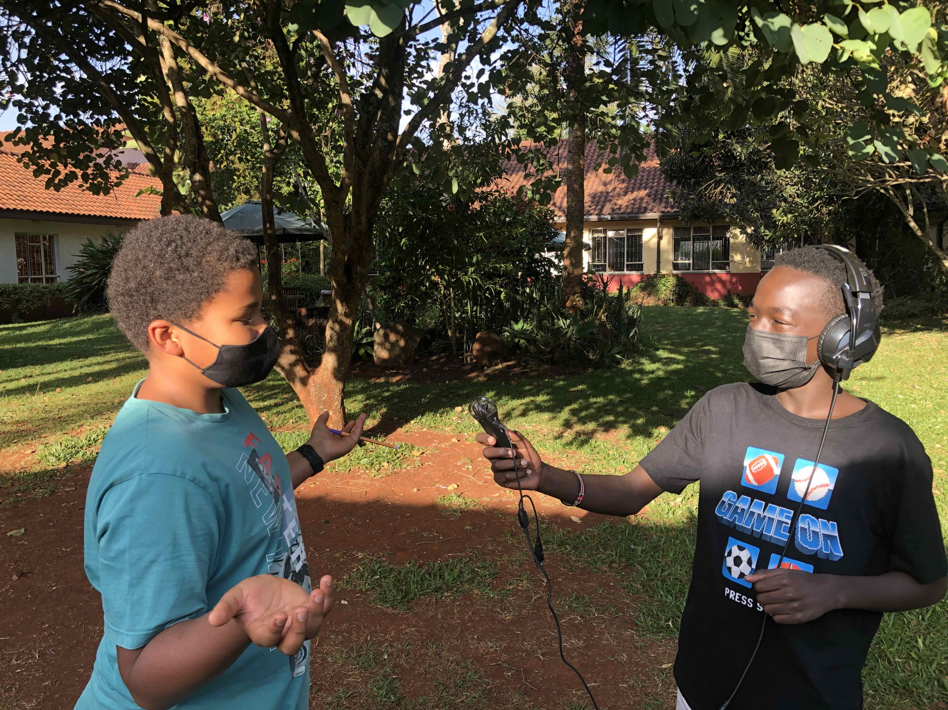
As a school with a full-day schedule, we want to give new rhythms to the school day in order to facilitate holistic learning.
6:45 a.m. Departure
5:45 p.m. Leisure time

Slide 6
Two days per week there is an optional offering: students can choose whether to take a 90-minute academic or academic-artistic-sports offering in the morning or after lunch. At least one academic course per week must be taken.
Student/parent/college evaluations show
the interest of the students in the academic content and an increase in school satisfaction,
an improvement in learning management and self-organization,
an effective differentiation,
a school day rhythm adjusted to the biorhythm.
The parents actively participate in creating and performing the offers.
At least three significant competitions are held per school year (e.g. competitions recognized by the Conference of Ministers of Education and Cultural Affairs, e.g. Kangaroo, Diercke Competition...).
The resulting free resources are to be used by the teaching staff for the development of the school.

Slide 7
 | Monday | Tuesday | Wednesday | Thursday | Friday
7:45-8:30
8:35-9:20
9:40-10:25
10:30-11:15
11:30-12:15
12:20-13:05
14:00-14:45
14:45-15:30
15:30-17:00
Elective Module 5/6
academic/ac:ar:spo
Elective Module 7-9
academic/ac:ar:spo
Biology-Project
Biology-Project
inter-class German Lessons
Elective Module 5/6
academic/ac:ar:spo
Elective Module 7-9
academic/ac:ar:spo

Slide 8
Homework...
"practice, deepen, consolidate, expand"
in class
Increase our students independence / self-regulation in weekly plans or project work
one study time in grades 5-8
as individual practice/self-study time.
Logbook as a "bridge" to you parents
Learning vocabulary, reading novels
remain tasks at "home"
...becomes schoolwork.

